Slide 1
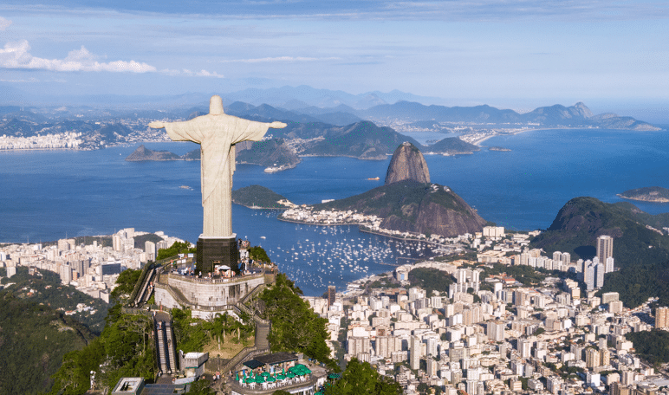
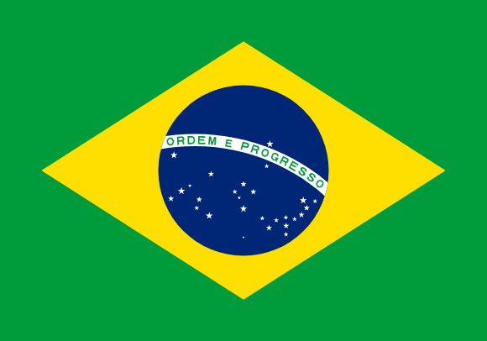
BRASIL

Slide 2
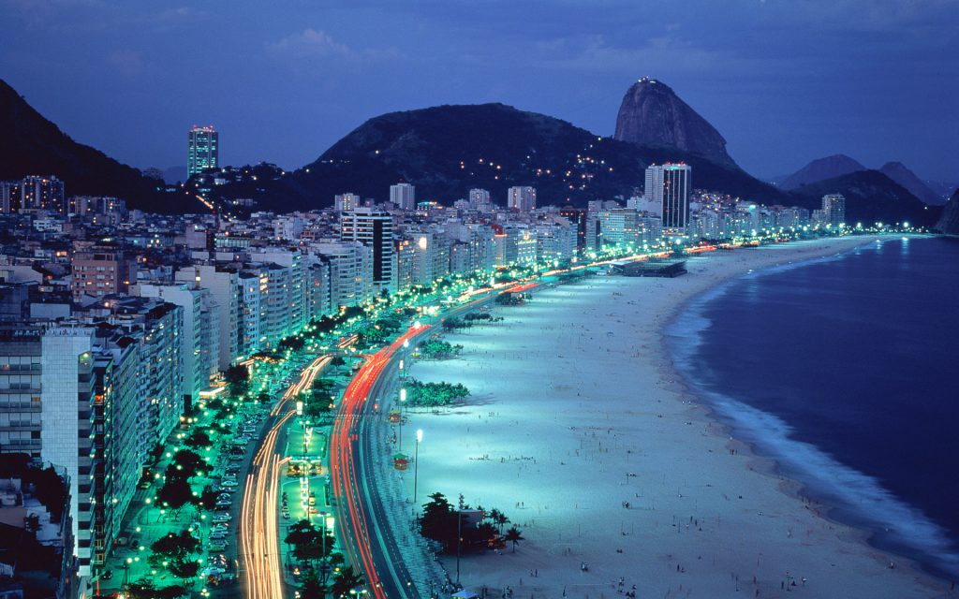

Slide 3
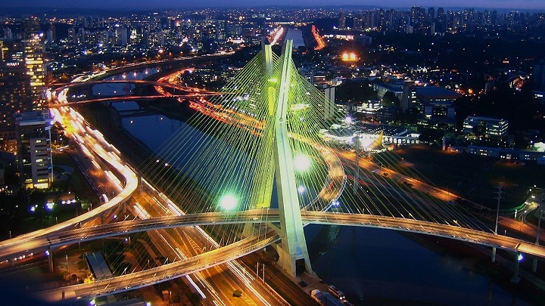
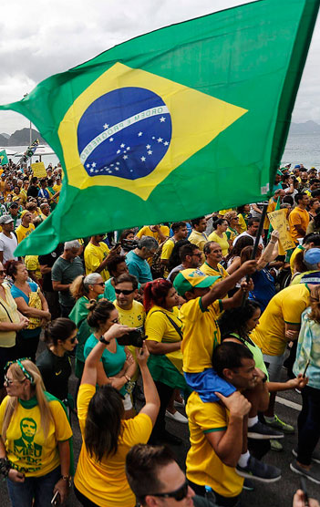
PRESIDENT OF BRASIL
POPULATION
POPULATION (2022)
DAY OF BIRTH
212.6 M
128.9 M

Slide 4
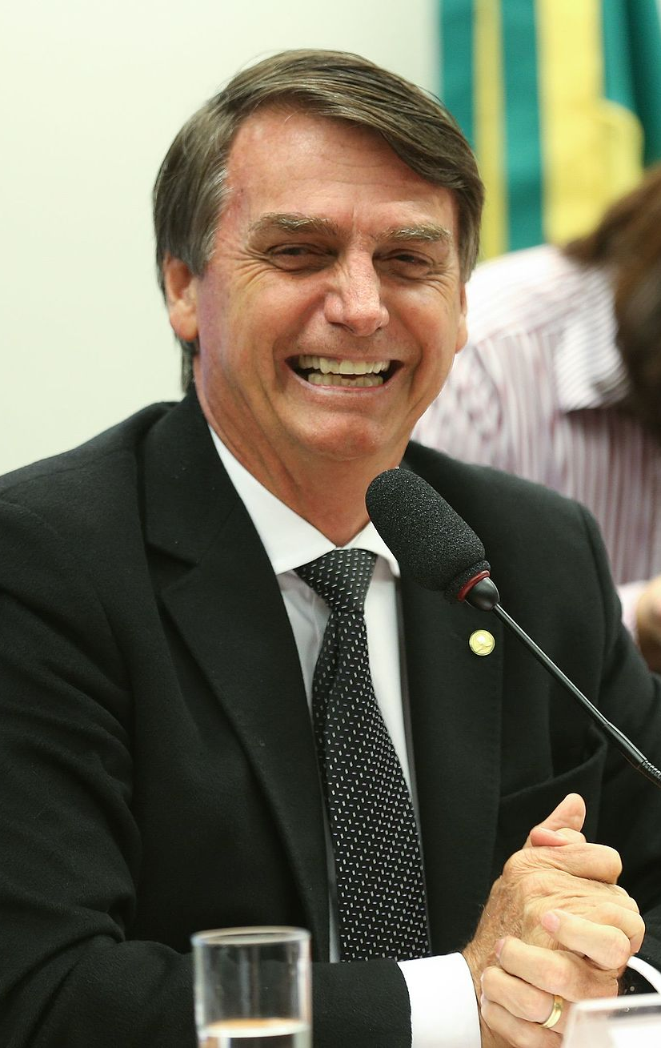
PRESIDENT OF BRASIL
DAY OF BIRTH
MARCH 21, 1955 (AGE 67 YEARS)

Slide 5
PRESIDENT OF BRASIL
WHO IS HE?
JAIR MESSIAS BOLSONARO IS A RETIRED MILITARY OFFICER AND BRAZILIAN POLITICIAN.

Slide 6
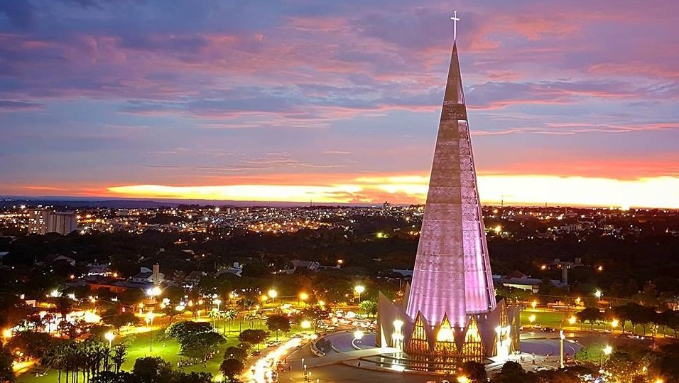
THE FLAG
PRESIDENT OF BRASIL
JAIR BOLSONARO IS THE 38TH PRESIDENT OF
BRASIL

Slide 7
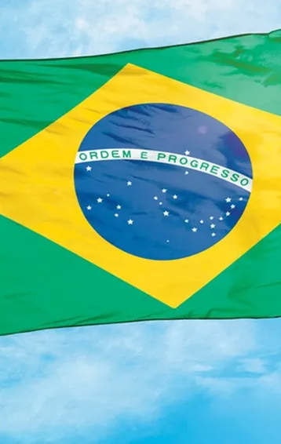
THE FLAG
ITS CREATORS CONSIDERED THAT THE GREEN AND YELLOW COLORS WERE REPRESENTATIVE OF BRAZILIAN PRODUCTION,

Slide 8
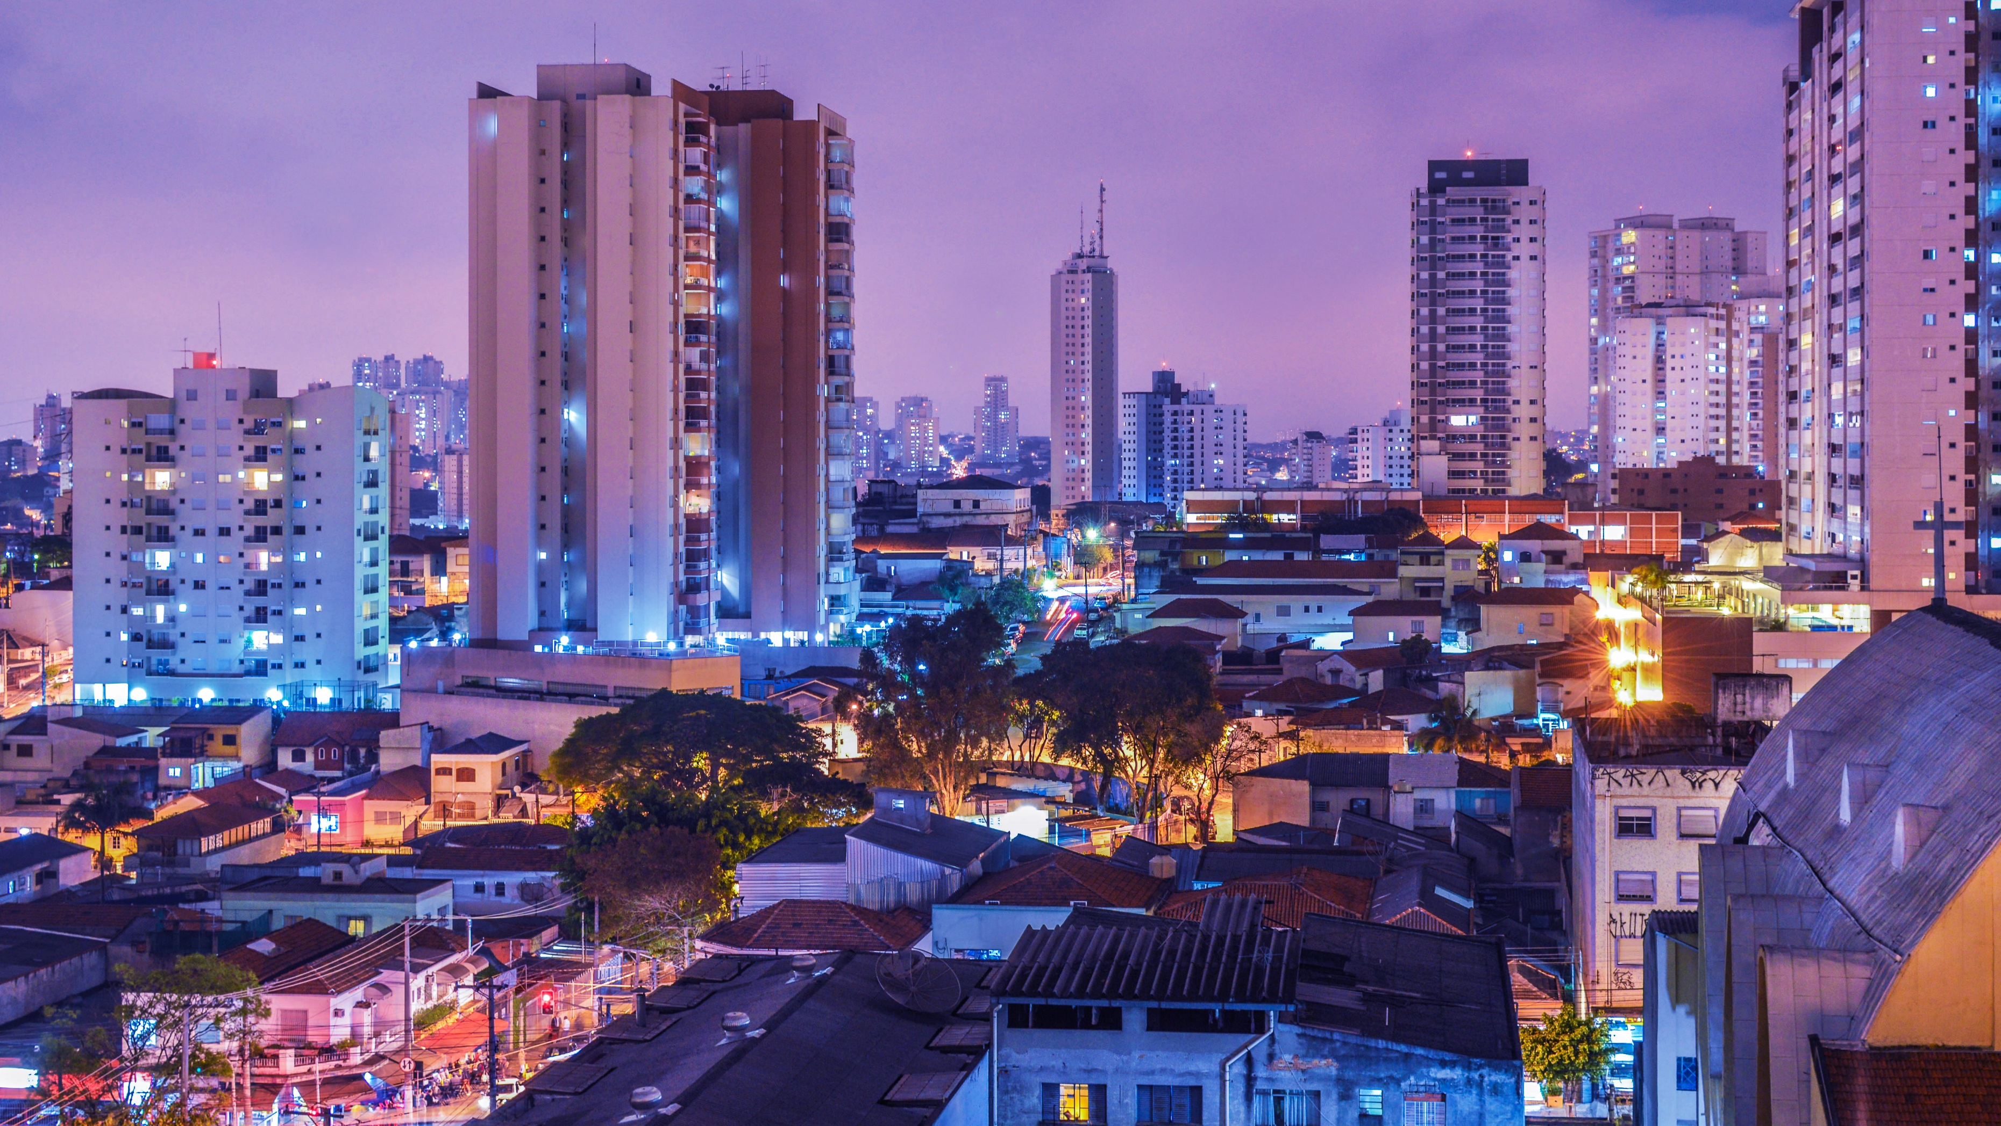
THE FLAG
BOTH WITH REGARD TO NATURE AND TO INDUSTRY AND THE HAND OF MAN.

Slide 9
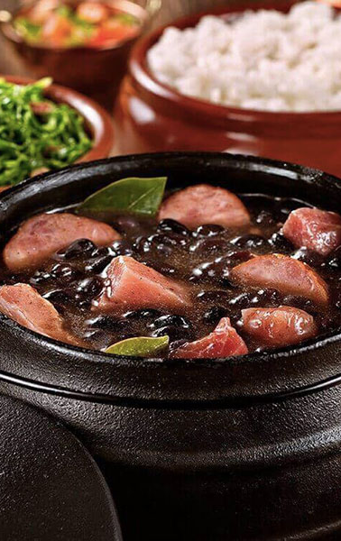
THE FLAG
THE GASTRONOMY
THE CIRCLE BLUE IS A SYMBOL TO REMEMBER THE SPHERE THAT REPRESENTED THE HONORARY PRINCIPALITY OF BRAZIL.
FEIJOADA
INGREDIENTS
BLACK BEANS
PORK MEAT
RICE
ORANGE SPRINKLED
THE SAUCER IS HEAVY
This Photo by Unknown Author is licensed under CC BY-NC-ND

Slide 10
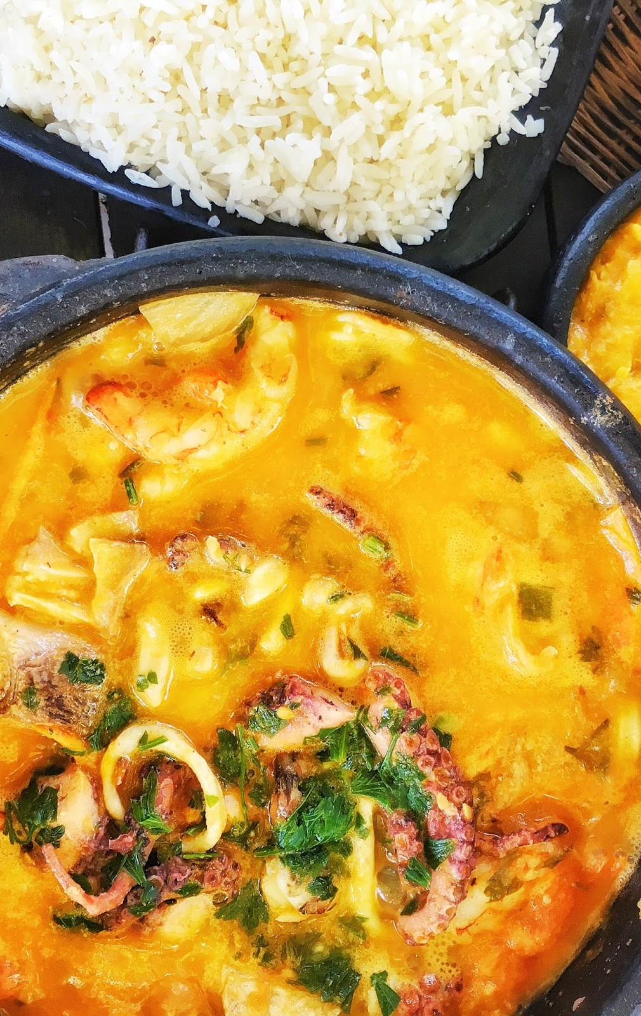
THE FLAG
THE GASTRONOMY
THE CIRCLE BLUE IS A SYMBOL TO REMEMBER THE SPHERE THAT REPRESENTED THE HONORARY PRINCIPALITY OF BRAZIL.
MOQUECAS
INGREDIENTS
SEAFOOD AND FISH MIX
PEPER
TOMATO
COCONUT MILK

Slide 11
THE FLAG
THE GASTRONOMY
THE CIRCLE BLUE IS A SYMBOL TO REMEMBER THE SPHERE THAT REPRESENTED THE HONORARY PRINCIPALITY OF BRAZIL.
MOQUECAS
INGREDIENTS
ONION
CORIANDER LEAVES
PALM OIL

Slide 12
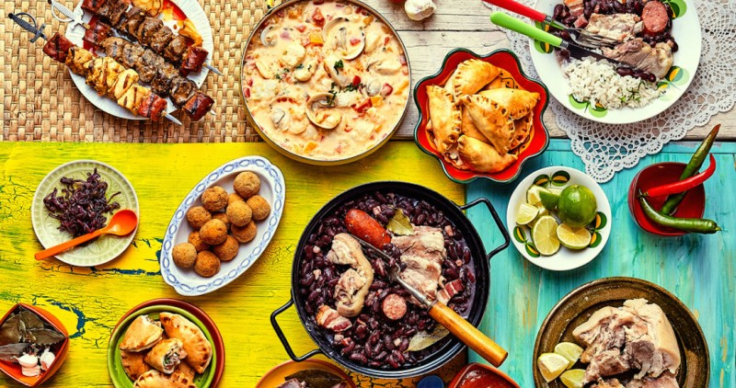
THE FLAG
THE GASTRONOMY
THE CIRCLE BLUE IS A SYMBOL TO REMEMBER THE SPHERE THAT REPRESENTED THE HONORARY PRINCIPALITY OF BRAZIL.
THESE ARE SOME OF A LOT OF DIFFERENT TYPES OF FOODS FROM BRASIL

Slide 13
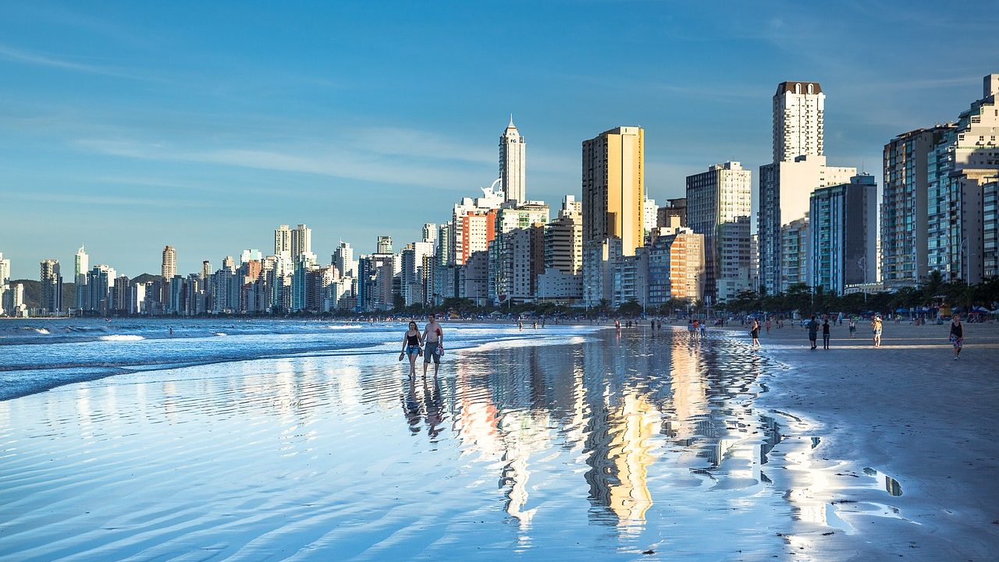
LANGUAGE
THE FLAG
THE GASTRONOMY
THE CIRCLE BLUE IS A SYMBOL TO REMEMBER THE SPHERE THAT REPRESENTED THE HONORARY PRINCIPALITY OF BRAZIL.
THESE ARE SOME OF A LOT OF DIFFERENT TYPES OF FOODS FROM BRASIL

Slide 14
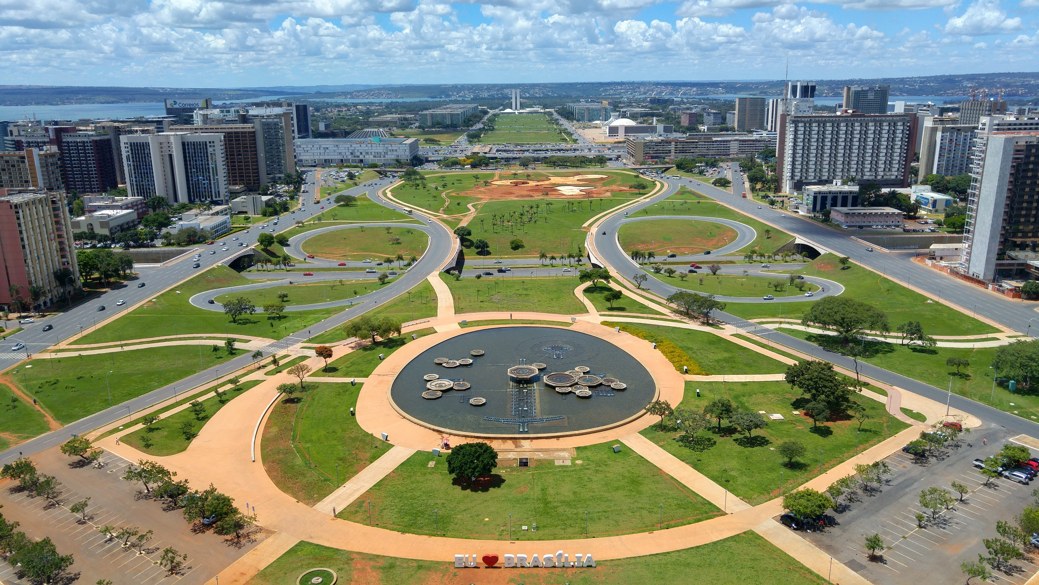
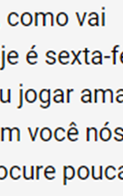
THE GASTRONOMY
LANGUAGE
PORTUGUESE
AND SPANISH
THESE ARE SOME OF A LOT OF DIFFERENT TYPES OF FOODS FROM BRASIL
HELLO – OI
HOW ARE YOU? - TUDO BEM?
TOMORROW -AMANHÃ

Slide 15
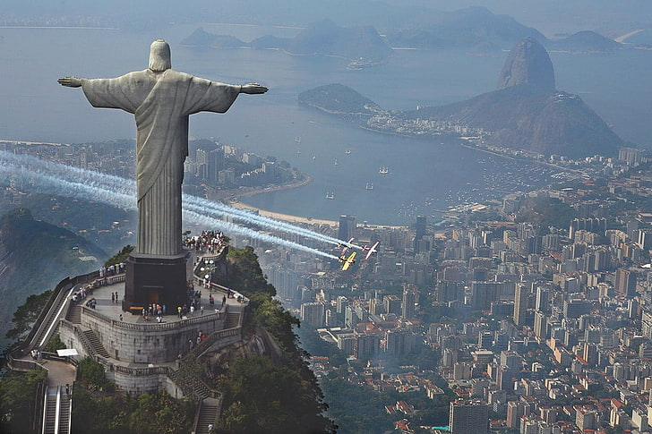
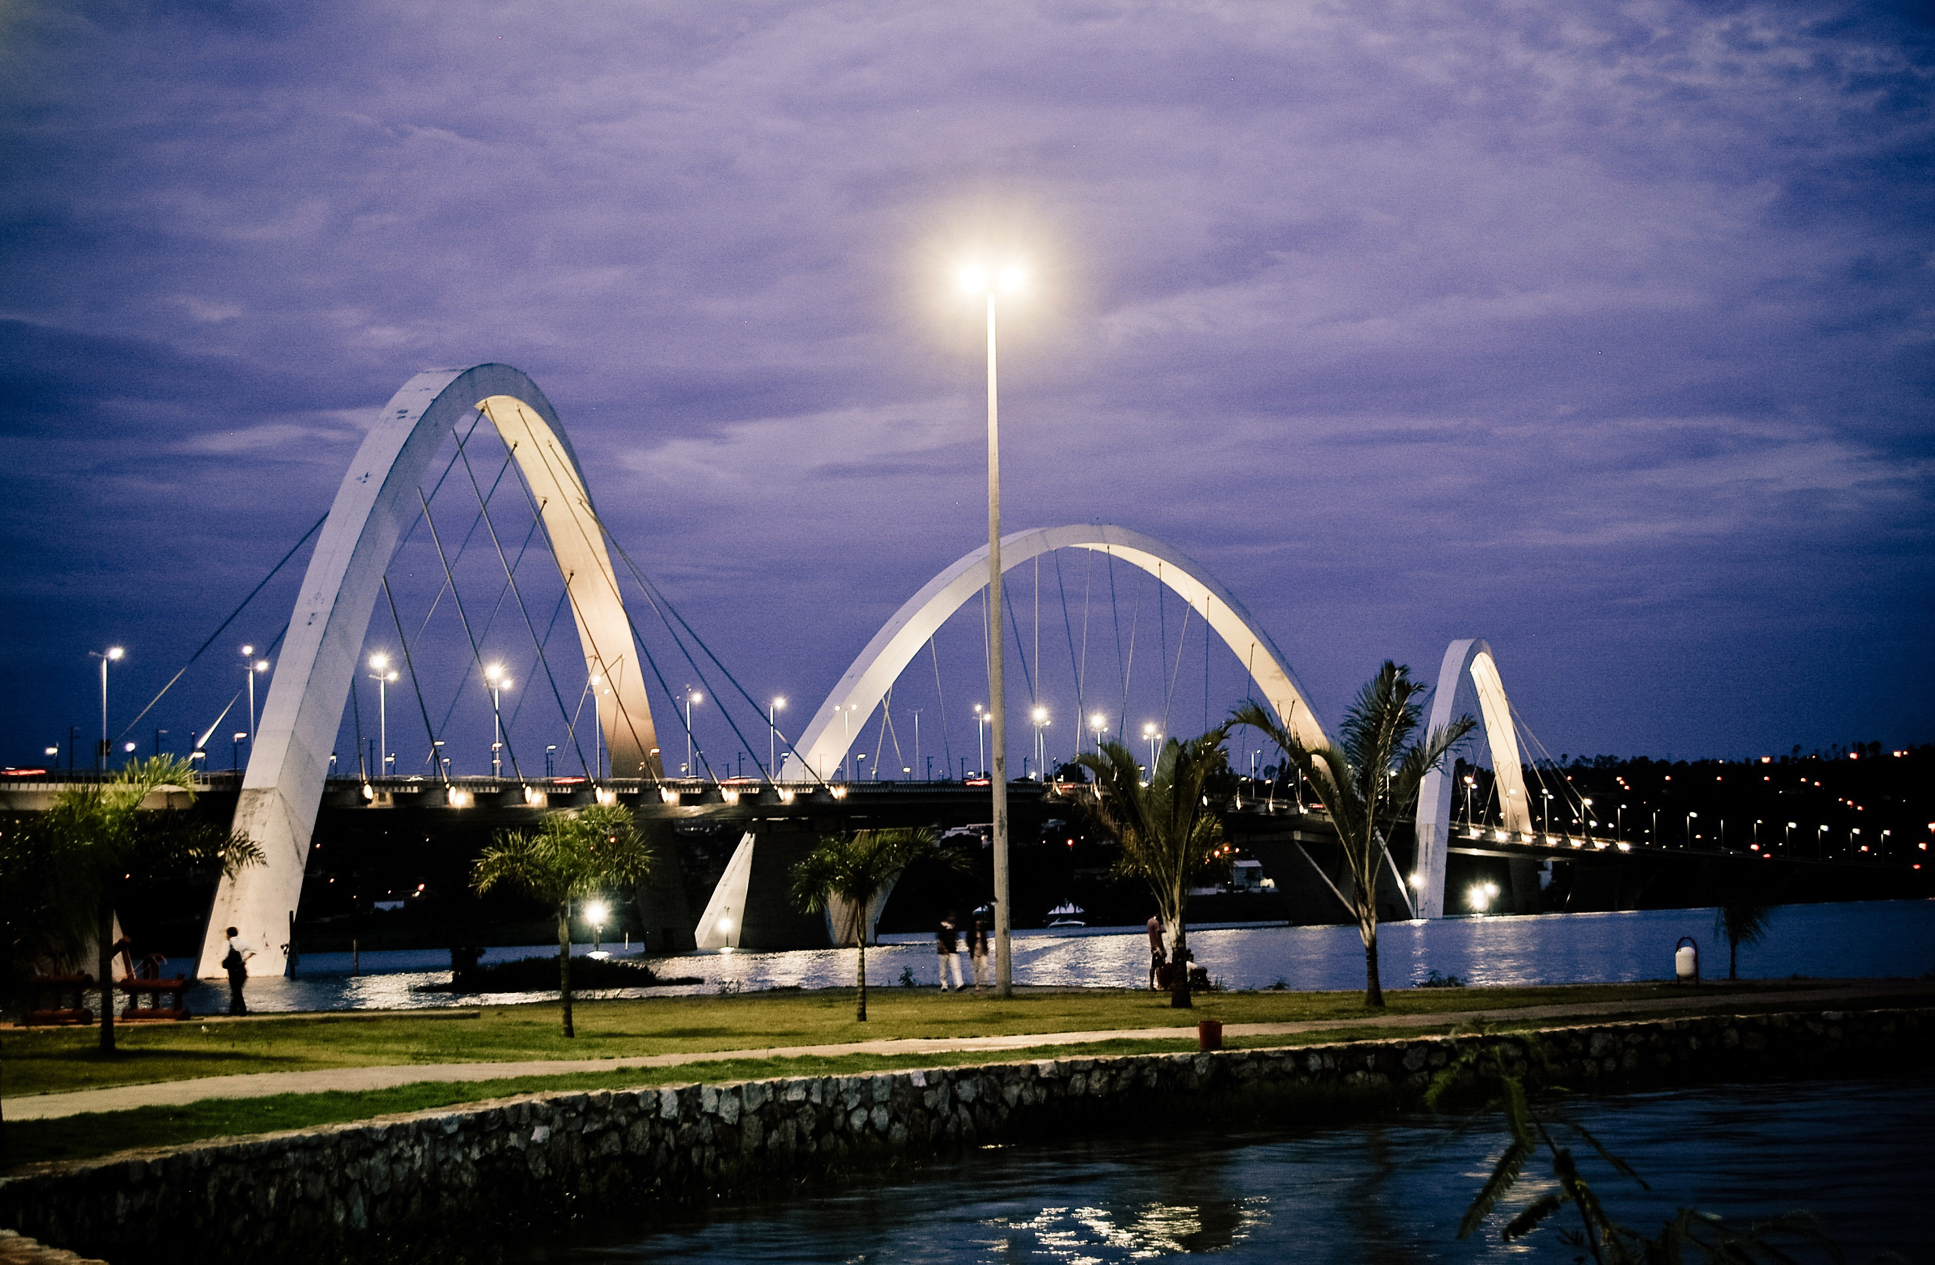
LANGUAGE
CAPITAL OF THE COUNTRY
PORTUGUESE
AND SPANISH
BRASILIA
HELLO – OI
HOW ARE YOU? - TUDO BEM?
TOMORROW -AMANHÃ
POPULATION
3.094.325
LANGUAGE
PORTUGUESE

Slide 16
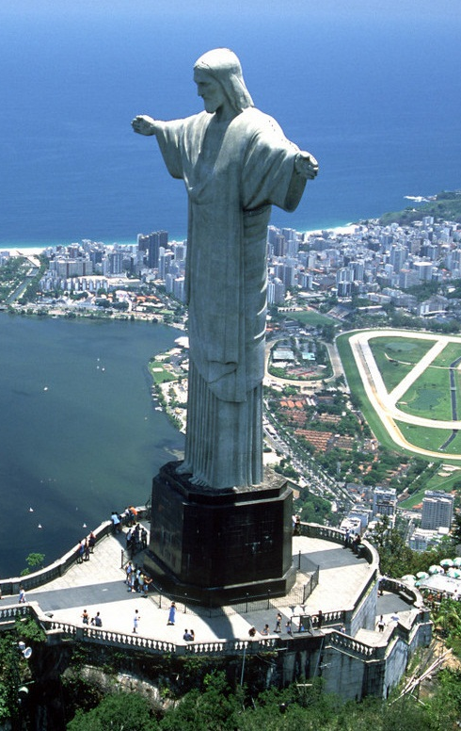
TOURIST PLACES
RIO DE JANEIRO
IS A BIG COASTAL CITY OF BRASIL.
IT´S FAMOUS BY THE BIG ENORMOUS STATUE OF THE CRISTO REDENTOR

Slide 17
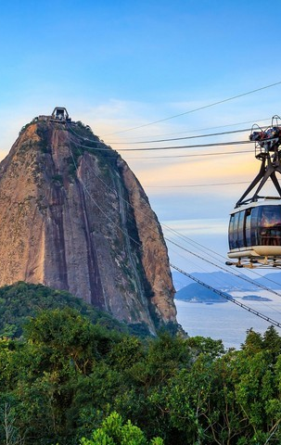
CAPITAL OF THE COUNTRY
TOURIST PLACES
THE PAN DE AZUCAR
BRASILIA
POPULATION
3.094.325
LANGUAGE
PORTUGUESE
IS A CRAG SITUATED IN THE RIO DE JANEIRO AND THERE YOU CAN RIDE A CABLE CAR

Slide 18
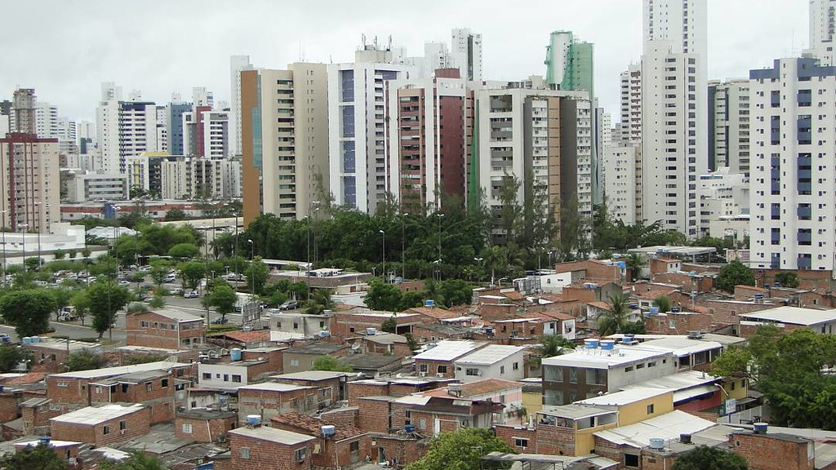
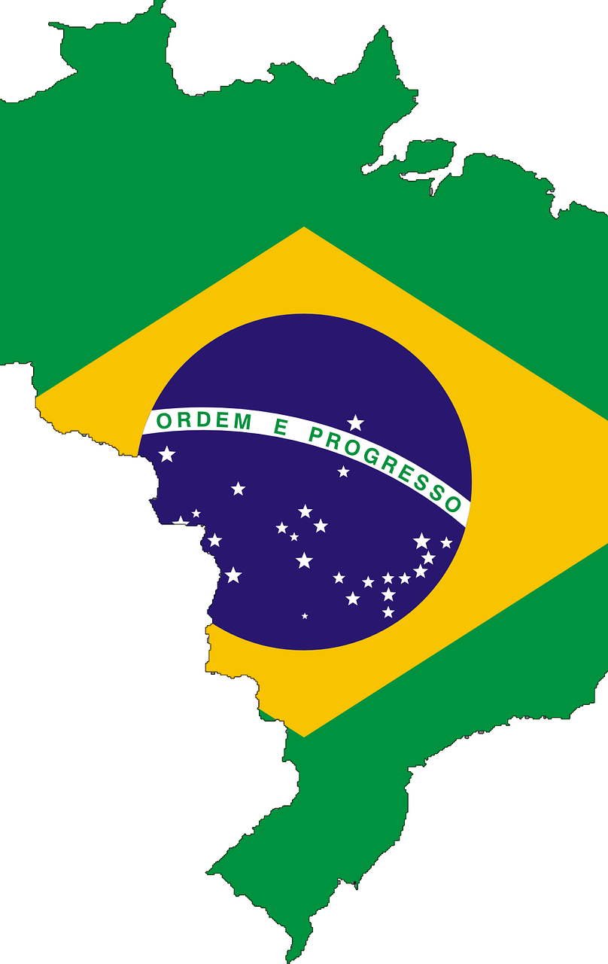
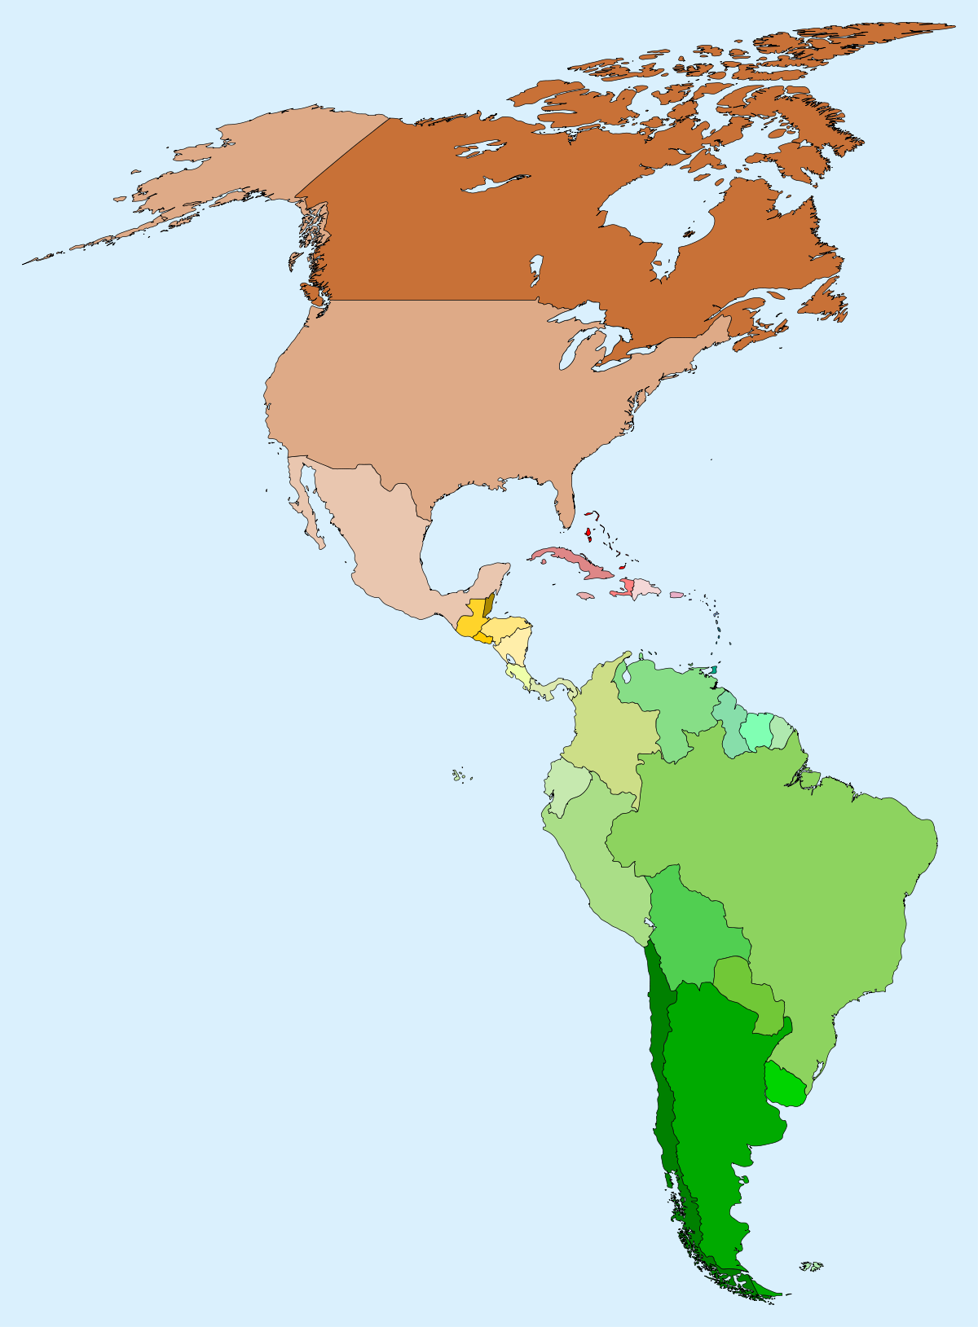
WHERE IS BRASIL?
BRASIL IS IN SOUTH AMERICA.
IT HAS A BORDER WITH ALL THE COUNTRIES OF SOUTH AMERICA EXCEPT CHILE AND ECUADOR

Slide 19
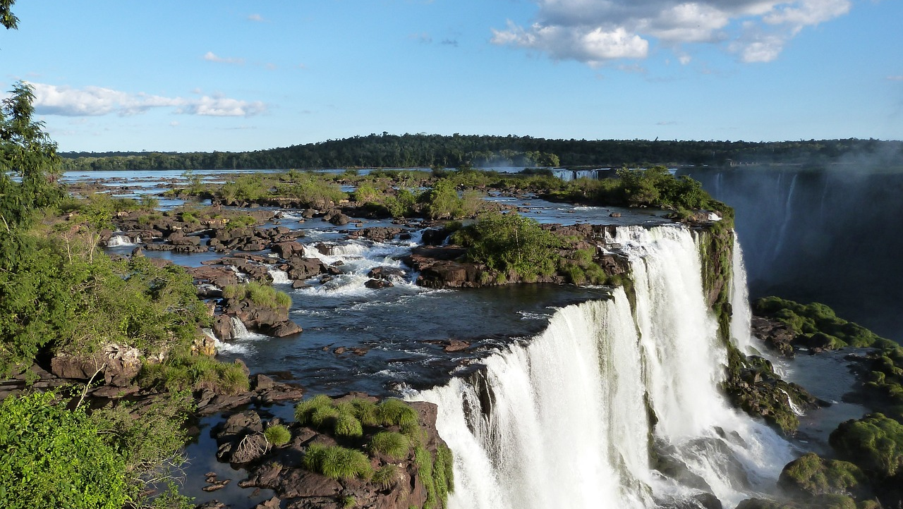
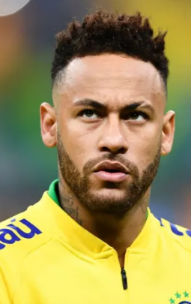
FAMOUS FROM BRASIL
NEYMAR - SOCCER PLAYER
KAKÁ - SOCCER PLAYER
RONALDINHO - SOCCER PLAYER
PAULO COELHO - NOVELIST

Slide 20
FAMOUS FROM BRASIL
IVETE SANGALO - SINGER
LUCIANO HUCK - TV PRESENTER
CLAUDIA LEITTE - SINGER
LUAN SANTANA - SINGER
ANITTA - SINGER

Slide 21
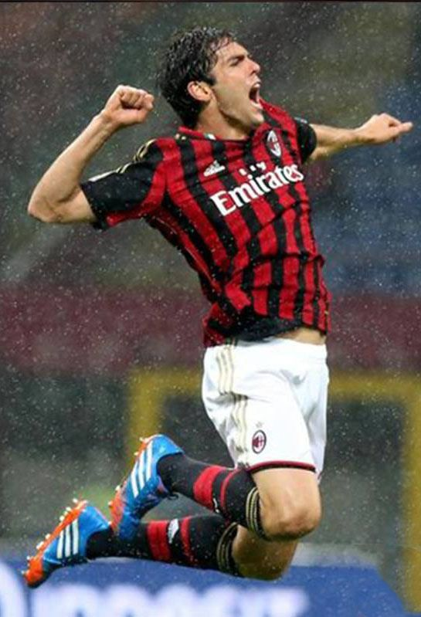
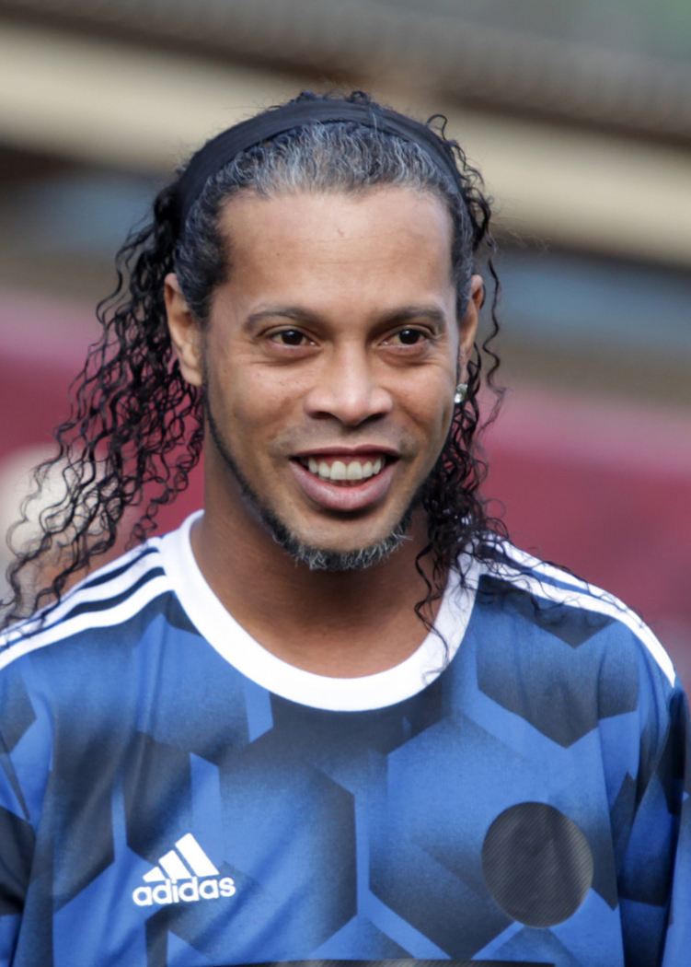
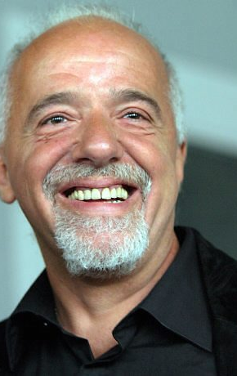
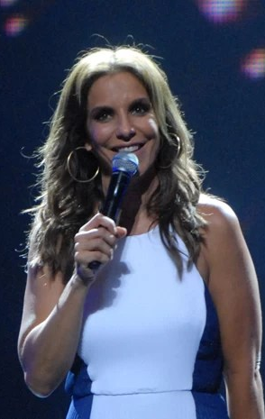
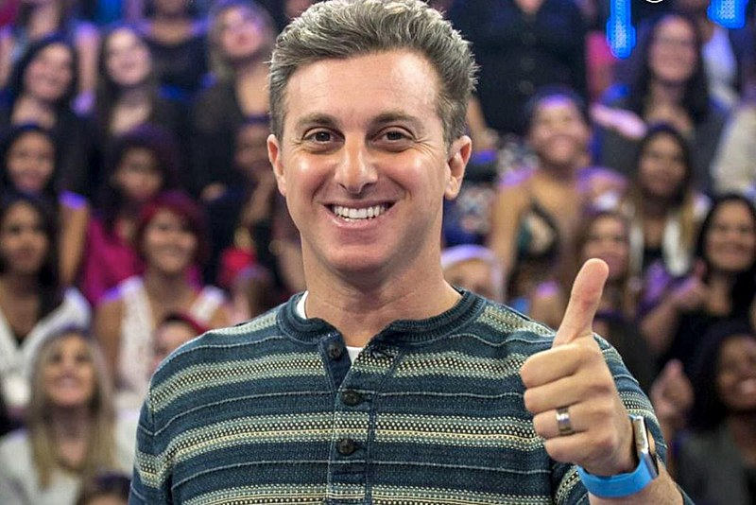
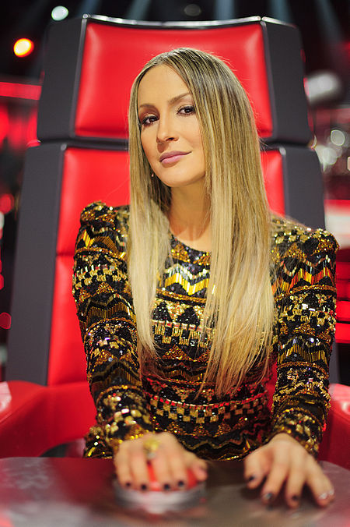
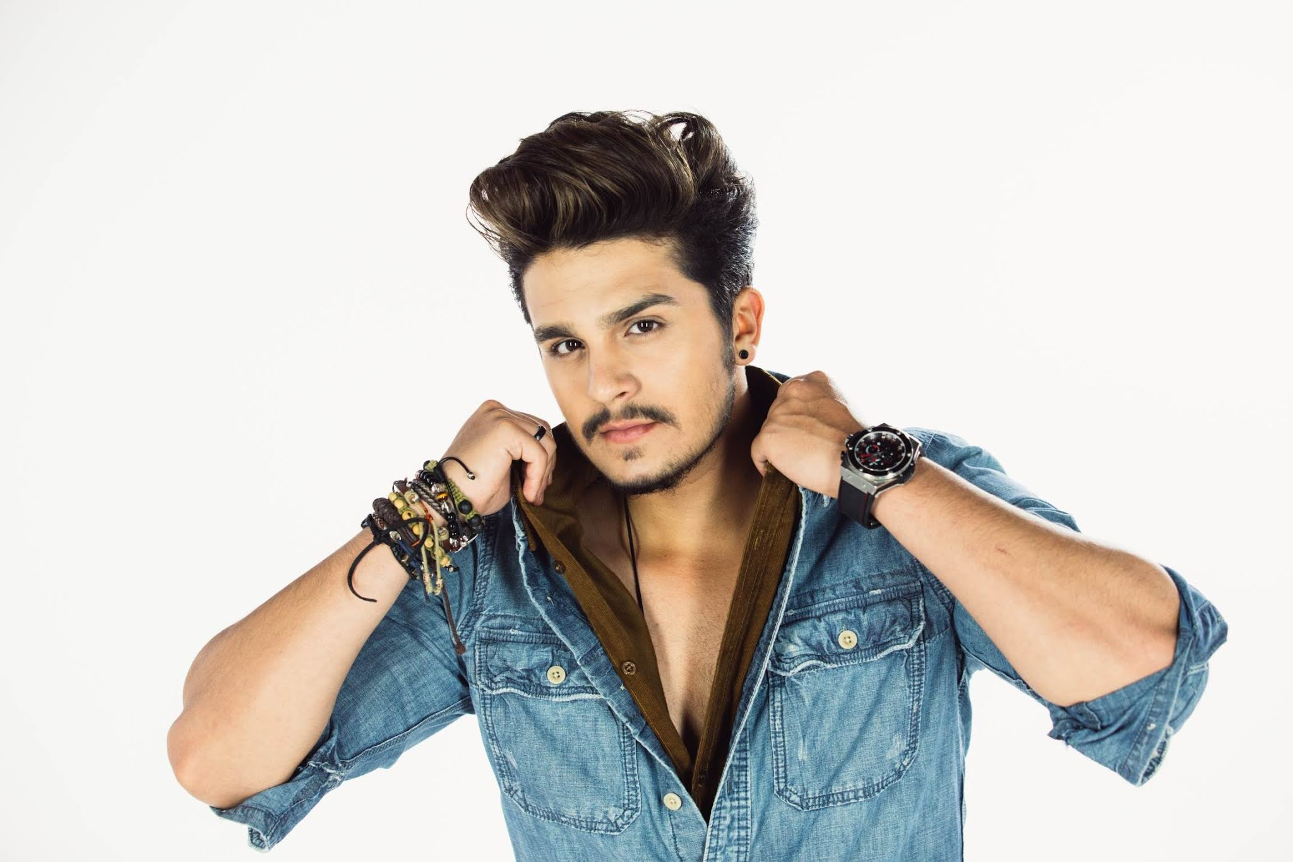
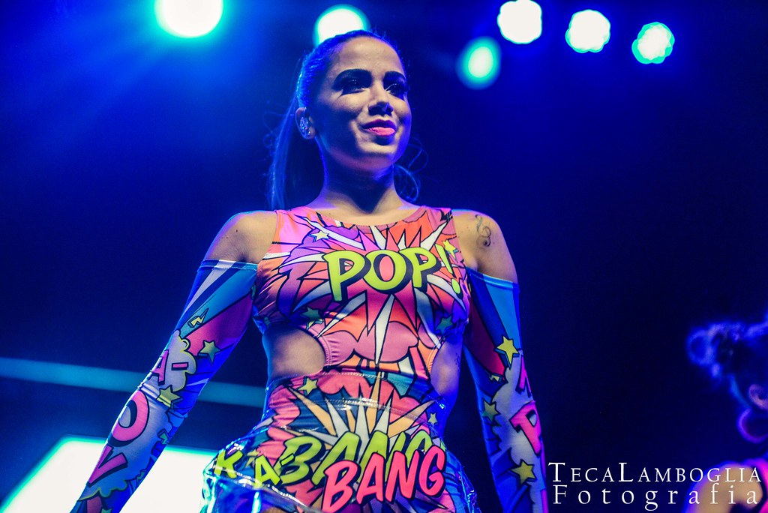
FAMOUS FROM BRASIL
NEYMAR
KAKA
RONALDINHO
PAULO
IVETE
LUCIANO
CLAUDIA
LUAN
ANITTA

Slide 22
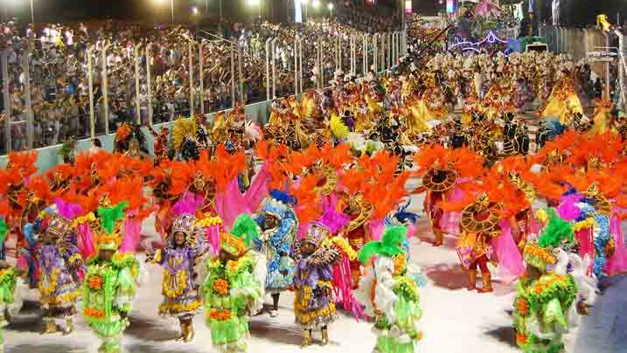
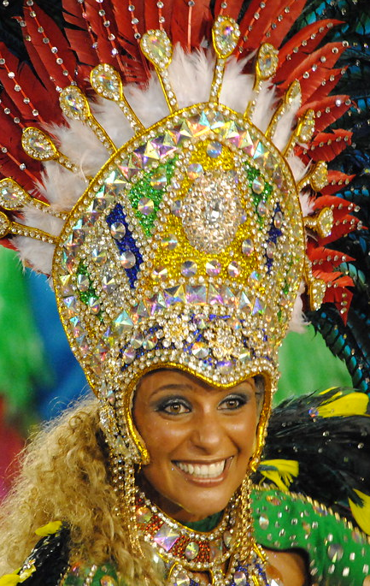
FAMOUS FROM BRASIL
CARNAVAL OF BRASIL
NEYMAR
KAKA
RONALDINHO
PAULO
IVETE
IT IS CELEBRATED ANNUALLY , ITS FOR ENJOY ONE LAST WEEK OF FESTIVITIES BEFORE THE 40 DAYS OF ABSTINENCE THAT ENDS ON EASTER, THE DAY OF CHRIST'S RESURRECTION
IT IS AT THE END OF FEBRUARY OR THE BEGINNING OF MARCH
IT START BETWEEN FRIDAY AFTERNOON AND ASH WEDNESDAY AT NOON
LUCIANO
CLAUDIA
LUAN
ANITTA

Slide 23
THANK YOU FOR YOUR ATTENTION
SOURCES
KIDS NATIONAL GEOGRAFIC
DATA COMMONS
AND MORE

